Slide 1

Session 2 – Using Inputs
HOW TO INPUT SIGNALS INTO AN ARDUINO AND USE THEM IN CODE

Slide 2
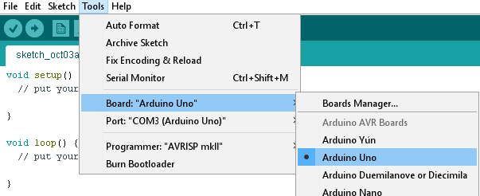
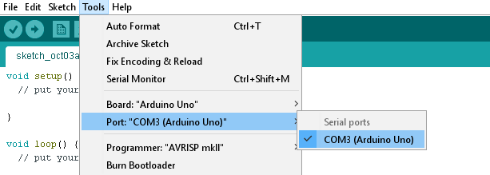
Connecting to the Arduino (Reminder)
Connect the Arduino via USB
Select the “Arduino UNO” board type
Select the right COM port
Try opening the Serial Monitor to see if it worked

Slide 3
Last Session
Output through digital pins:
Set up using pinMode(pin, OUTPUT);
Set by digitalWrite(pin, state);
PWM pins (3, 5, 6, 9, 10, 11):
Have a level between 0 and 255, corresponding to a voltage between 0V and 5V
Set by analogWrite(pin, level);
For loops: for(start; condition; iterative){ }
While loops: while(condition){ }
Millisecond delays: delay(ms);
Defining integer variables: int x;
Incrementing variables: x++;
Decrementing variables: x--;

Slide 4
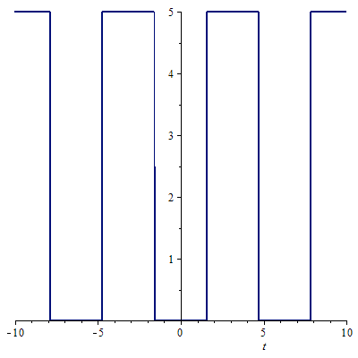
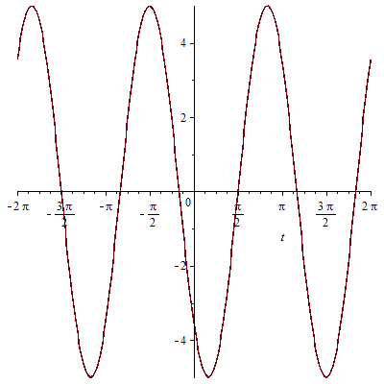
Types Of Signal
Digital Signal
Analogue Signal

Slide 5
Digital Signals
Easy for microcontrollers to work with
Only have two possible values
Information is transmitted by a series of HIGHs and LOWs
For Arduino UNO, a HIGH is +5V and a LOW is 0V
BEWARE! Not all devices use 5V – some Arduinos use 3.3V

Slide 6
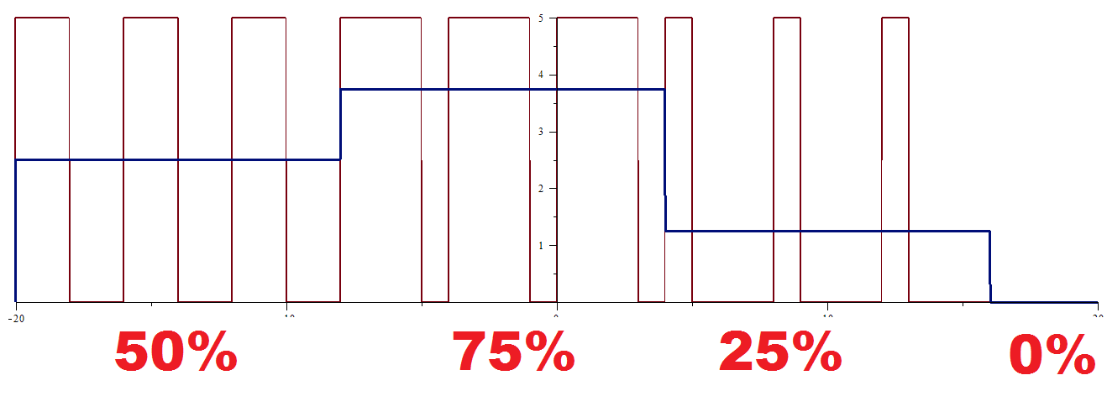
Analogue Signals
Difficult for microcontrollers to understand
Can have ANY value
Information can be transmitted by the amplitude or the frequency of the signal
The Arduino can (approximately) read analogue signals, but cannot output true analogue – remember PWM?

Slide 7
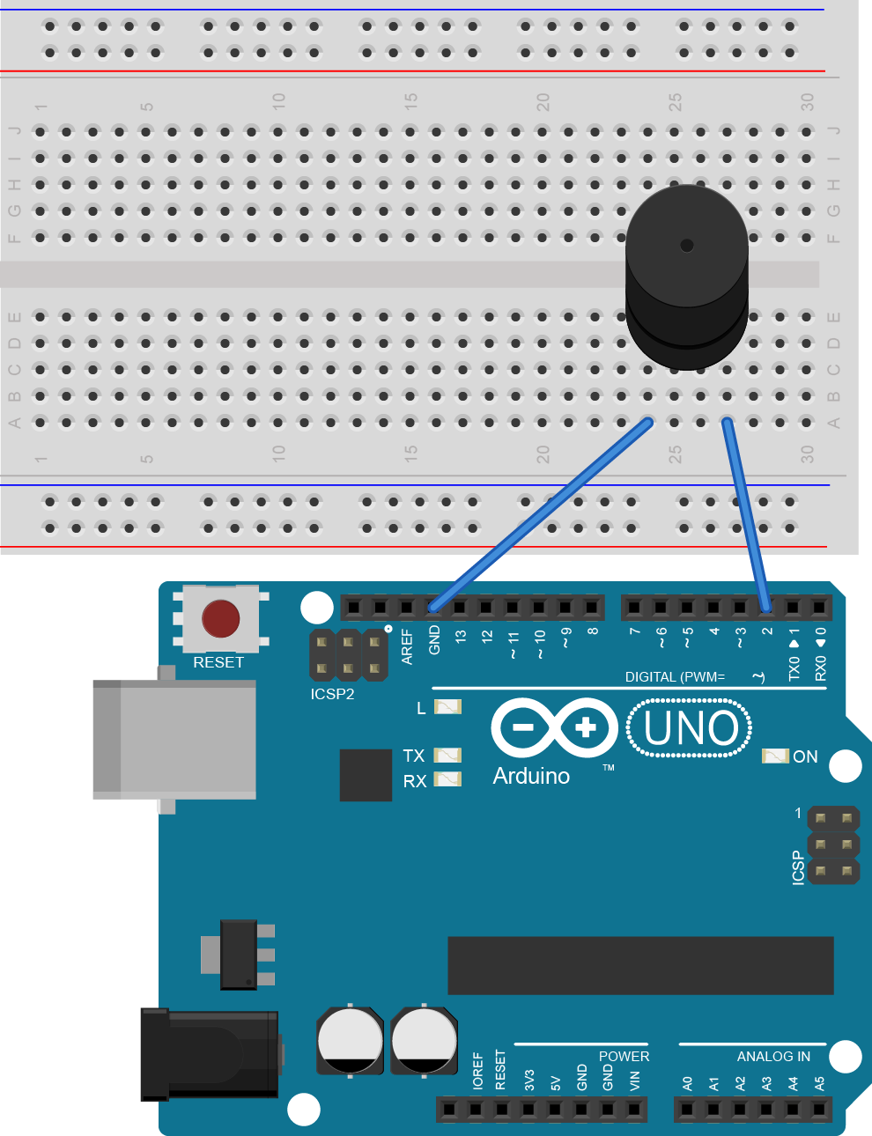
Digital Output - Easy Square Waves
Square waves are the simplest form of digital signal
We can use the tone function to produce square waves – for example, to drive a buzzer
Tone allows us to set the square wave’s frequency – tone(pin, freq);
We can end this using noTone(pin);
Tone works for frequencies between 31Hz and 65535Hz
Connect a buzzer to your Arduino
Let’s make some annoying noises!

Slide 8

Basic Buzzer Code
The buzzer will buzz at 440Hz for one second and then be silent for one second; this repeats forever
Try making a siren by playing a high tone and a low tone one after another
How could we use a for loop to make a tone of increasing pitch?

Slide 9

Buzzer - Example
Produces a train of 5ms tones from 400Hz to 1500Hz repeatedly
Note the use of freq+=10 in the iterative operation; this is shorthand for freq = freq + 10 so is incrementing by 10 each time – think about similar operations that may exist

Slide 10
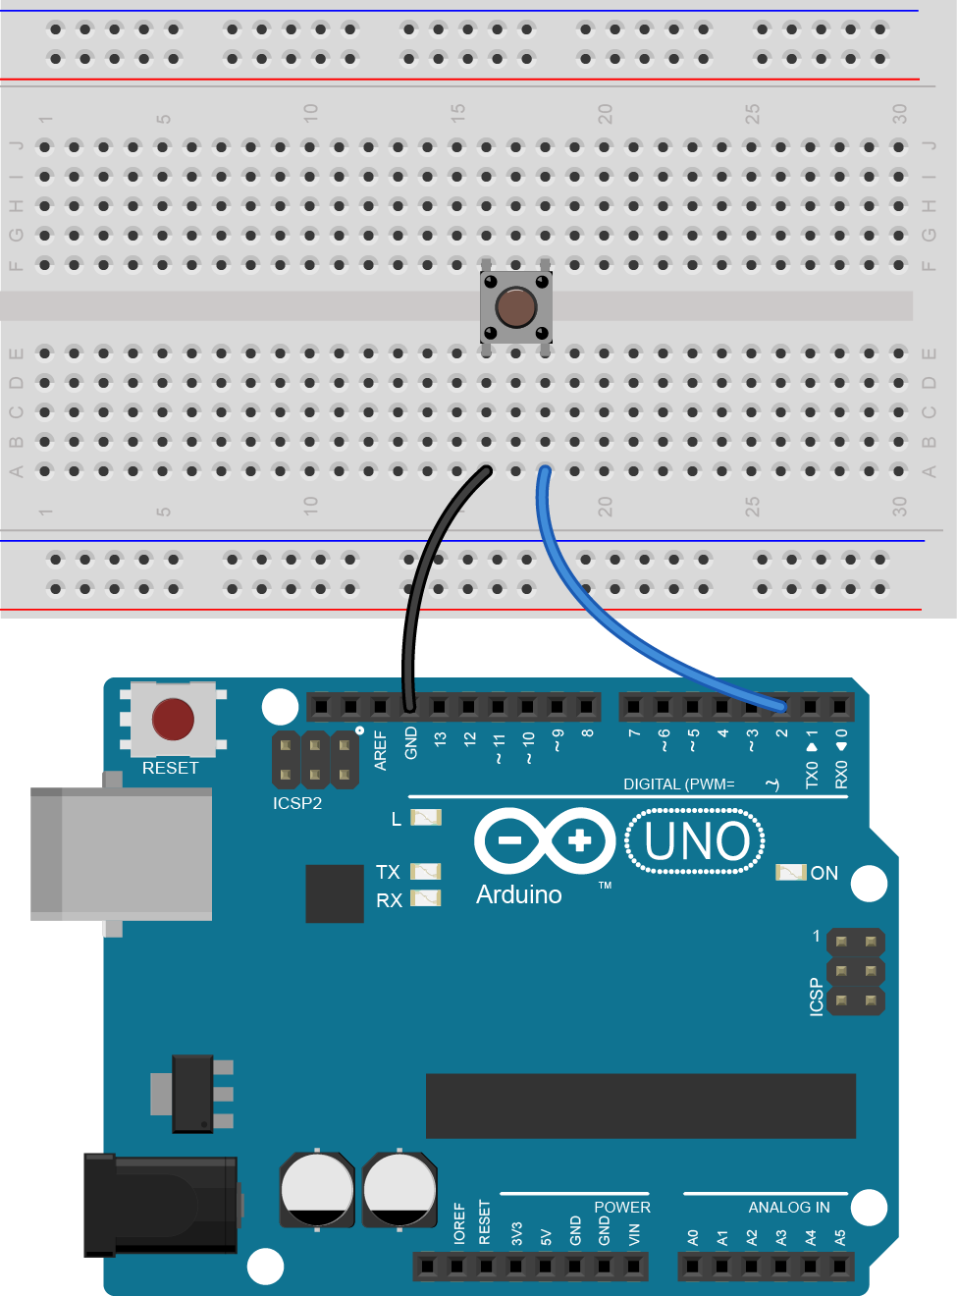
Digital Input - Switches
Connect a switch to your Arduino as shown
The switch is between pin 2 and ground (0V)
When the switch is pressed, pin 2 connects to 0V and goes LOW
When the switch is released, pin 2 is connected to nothing
The Arduino has an internal pullup resistor that we can enable to pull pin 2 to +5V (HIGH) when it is released
We set this up using pinMode again

Slide 11

Digital Input
buttonPin is initialised as an INPUT_PULLUP using pinMode
The inbuilt LED on the Arduino displays the state of buttonPin (pin 2), which is sensed using digitalRead(pin);
buttonState is high when buttonPin is high – ie when the switch is not pressed – so the LED turns off whenever the switch is pressed
Try initialising buttonPin as an INPUT – what happens?
Connect a resistor between buttonPin and +5V; does this solve the problem?
Think about how you could instead make the LED come on when the switch is pressed

Slide 12
Edge Detection
The previous example showed how to detect a change in the level of a digital input
Digital signals usually change at sharp edges – known as rising edges (low -> high) and falling edges (high -> low)
It can be useful to detect these edges and make a program only do something when there is an edge
For example, make the LED change state each time the switch is pressed
First we need to learn some control flow...

Slide 13
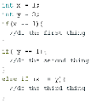
Edge Detection – If Statements
If statements allow us to control program flow
The standard structure is if(condition){ } where condition is some sort of expression
The code in the curly brackets is only executed if the condition is true
If there is an else statement after an if statement, it is only executed if the condition is false
Note the double equals sign == which is used when comparing two values
Also note != which stands for “not equal to”

Slide 14

Edge Detection
This isn’t as scary as it looks!
digitalRead is used to find the new state of the button
If this is different to the previous (stored) state then an edge has been detected
Looking at the new state of the button tells us if it was a rising or falling edge
The state of the LED (ledState) is then toggled
Note the use of ! to mean “not” to switch ledState between LOW and HIGH each time
Try this out – how well does it work?

Slide 15
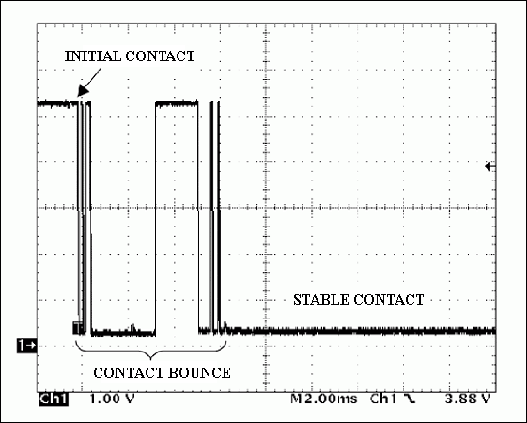
Switch Bounce
Switches aren’t perfect!
The metal contacts inside the switch bounce against each other before settling, resulting in lots of edges
This is why the LED seemed to trigger randomly with each press and not always appear to toggle
We can solve this in software or hardware

Slide 16
Hardware Debounce
A hardware debounce is easily implemented by placing a capacitor across the switch
Capacitors are components that store small amounts of electrical energy
The capacitor charges up when the switch is open
When the switch is pressed it takes time for the capacitor to discharge – this smooths out the edges caused by switch bounce
Try adding a capacitor now – does it help?

Slide 17
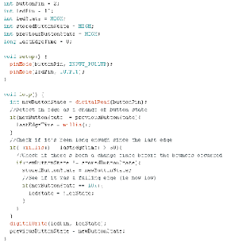
Software Debounce
Again, not as scary as it looks!
The millis() function gives us the number of milliseconds since the Arduino started/reset
If an edge occurs, the time of the last edge is recorded as lastEdgeTime
After 50ms since the last edge, the new state is checked against the storedButtonState, which is the last stable state of the switch
Then the edge type is checked and the LED toggled if needed
Only try this if you really want to!

Slide 18
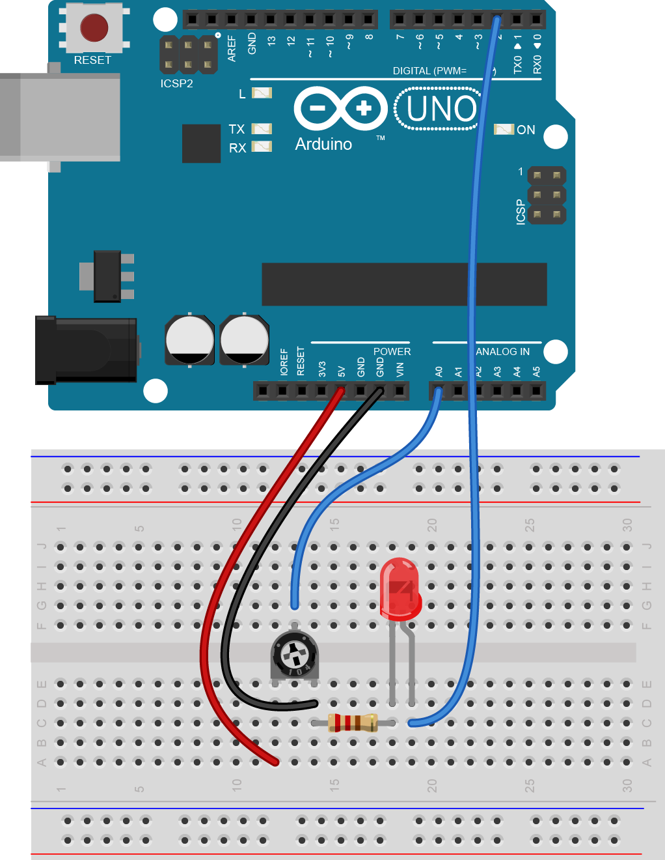
Analogue Input - Potentiometers
A potentiometer is a component that can be used to produce a varying voltage
Connect up the components as shown here – you should recognise the LED part of the circuit from the last session
The outside legs of the potentiometer are connected to +5V and 0V, and the voltage of the middle leg will change as the dial is turned
The Arduino can only read analogue signals using its six analogue pins – labelled A0 to A5
The analogRead function takes the analogue value and translates it to a number between 0 and 1023

Slide 19
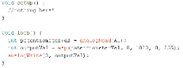
Analogue Input
potentiometerVal is read using the analogRead function on pin A0
outputVal uses the map function to map the value from 0-1023 to 0-255
This value is given to the LED using analogWrite

Slide 20
Plenary
Signals are classed as either Analogue or Digital
Producing square waves:
To start up: tone(pin, freq);
To end: noTone(pin);
Digital inputs:
With pullup: pinMode(pin, INPUT_PULLUP);
Floating: pinMode(pin, INPUT);
Reading: digitalRead(pin);
Analogue pins - addressed A0 to A5
To read: analogRead(pin);
If statements: if(condition){ }
Else statement else can follow if, executes if condition false
Comparators ==, !=, >=, <=, >, <
! can be used as an operator for “not”
Switches suffer from switch bounce – debounce using hardware (capacitor) or software (millis() )

Slide 21
Final Challenges
Try some of the following:
Make a button toggle between an LED output and a buzzer output
Make an LED fade as a potentiometer is turned
Make a barchart display using LEDs and control it with a potentiometer
Make an RGB LED fade colours based on the potentiometer
Make a potentiometer control the frequency of a buzzer

